Slide 1

Workshop

Slide 2
Aims:
Understand how your child is taught Read Write Inc. in school.
Understand how to support your child with reading and writing, in line with the Read Write Inc. programme.

Slide 3
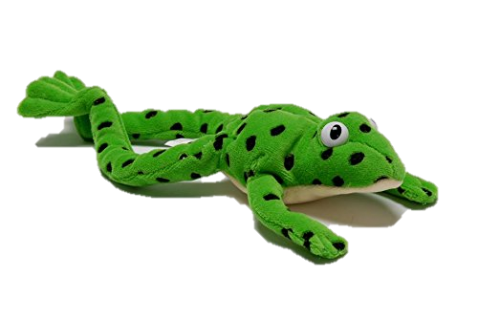
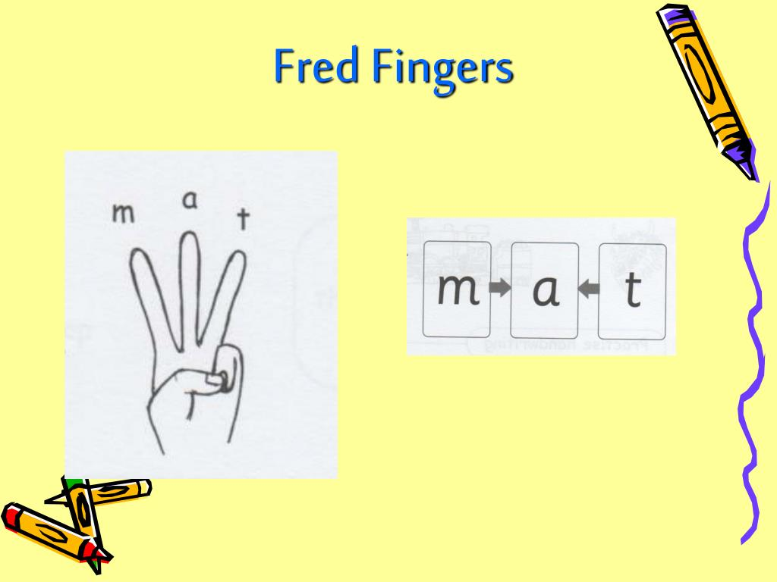

Meet Fred!
He helps your child read and write!

Slide 4
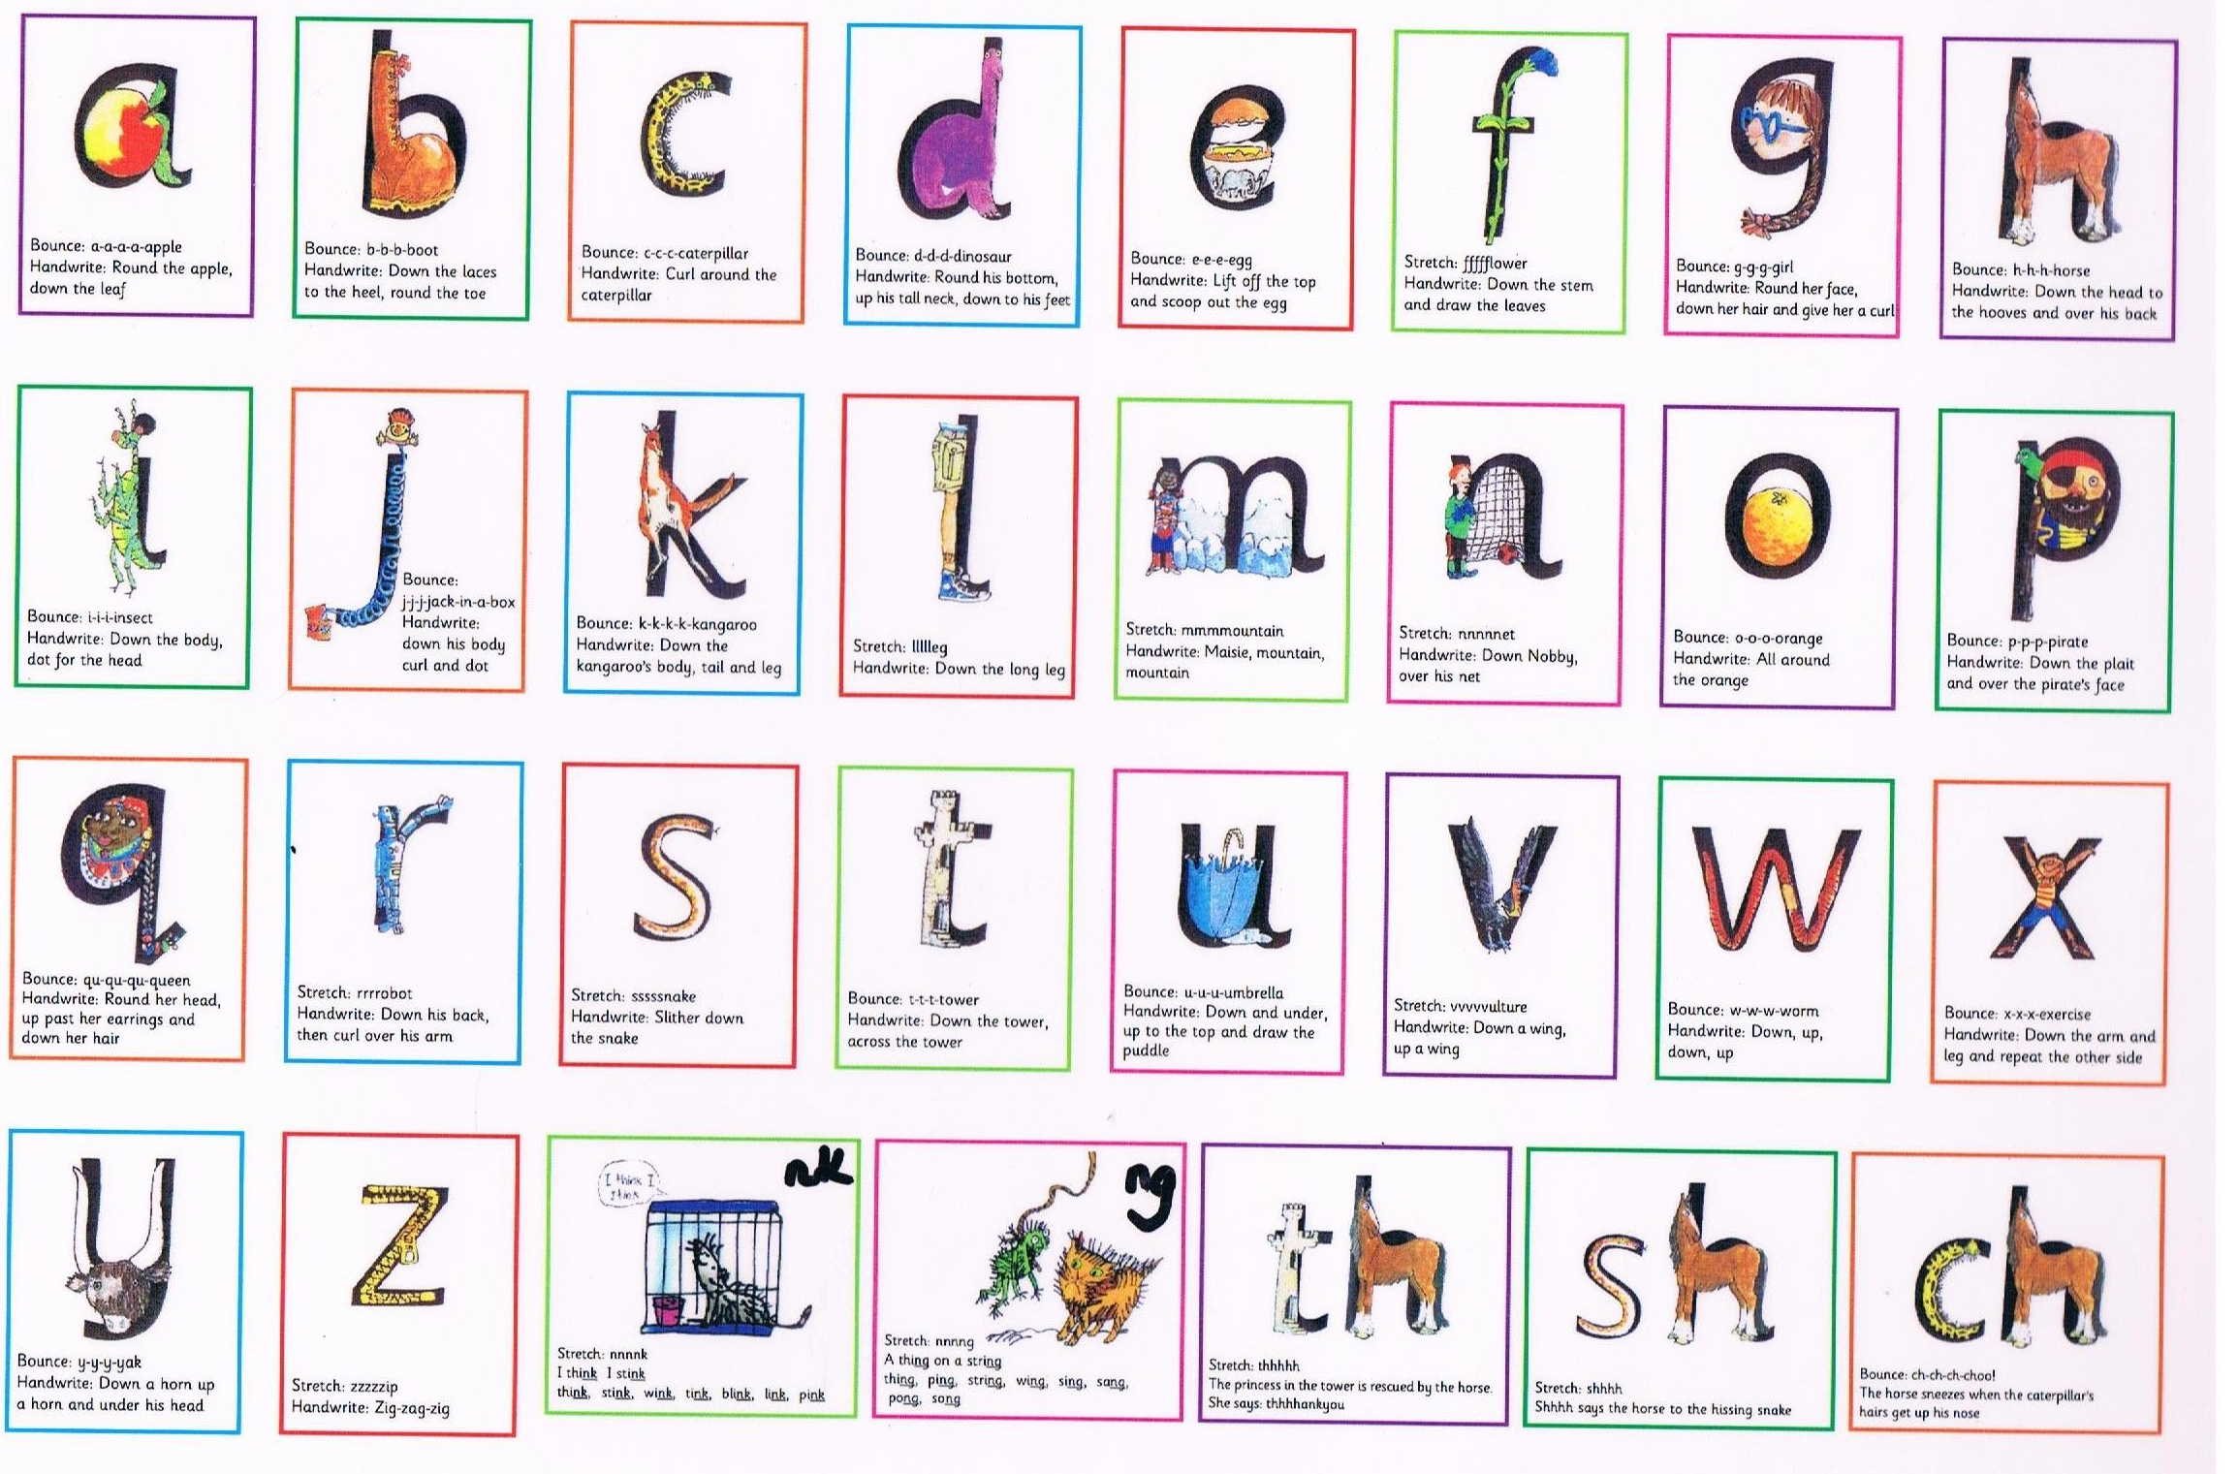
Learning sounds
https://www.google.com/search?q=read+write+inc+how+to+pronounce+the+sounds&rlz=1C1GCEV_enGB972GB972&oq=read+write+inc+how+to+pronounce+the+sounds&aqs=chrome..69i57j0i390l2.10833j1j7&sourceid=chrome&ie=UTF-8#kpvalbx=_fVYPZN-AFoOBhbIPj9y9gA8_29
Picture cards

Slide 5
Lesson time!
You are going to join Miss Daniels or Miss Chauhan for a short Read Write Inc. session. This is your opportunity to ask the teacher any questions you might have.
Don’t worry, Fred will be joining us too!

Slide 6

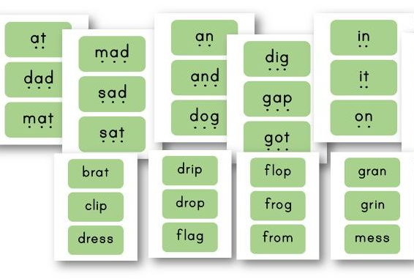
What you can do at home
Incidental Fred talking
”Get your c-oa-t.” “Look, there is a c-a-t!”
Flash sound/word cards at home…this could be after dinner, before bed or even during bath time!

Slide 7

Your child has an Oxford Owl login, so they can practice Read Write Inc. at home.
https://www.oxfordowl.co.uk/

Slide 8
Thank you for coming to this workshop!
If you think of any questions about Read Write Inc., please do not hesitate to ask at any point…the teachers are always here to help!

